Slide 1

ROBOKIDS
ACTIVITY 4

Slide 2
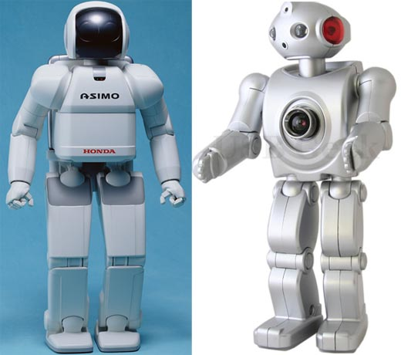
Robots around the world
This video shows an Asimo humanoid Robot from Japan. It has taken 10 years to develop the robot to work like this.
http://www.youtube.com/watch?v=cAL1G5ya214&feature=player_embedded

Slide 3
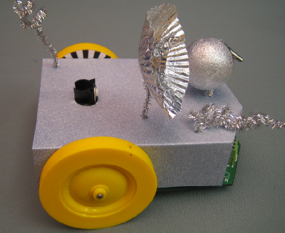
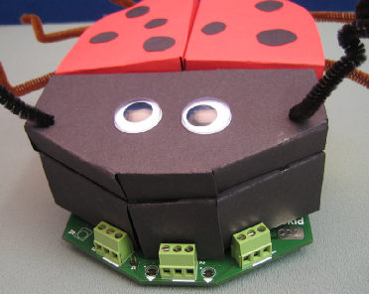
AIMS of Activity 4
Carry out a class competition based on robot driving skills.

Slide 4


Activity 4 Materials
Working robots
Robot storage boxes
Stop watches

Slide 5
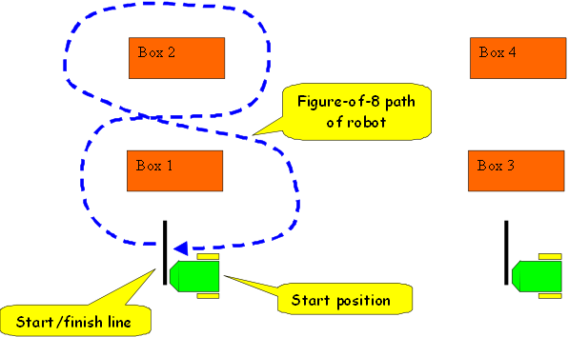
Activity 4 Race Course
We have built a competition arena using cardboard boxes and strips of black tape.
It will look a bit like this!

Slide 6
For each team
Set your robots into mode “J1” and place at the start positions. Use sequence “2A_D_A”
When ready, the referee will issue a go command and will start a stopwatch.
The first member of the team will drive a figure–of-8 path round the boxes. When reaching the finishing line the second member of the team will take over and repeat the path.
Finally, the third team member will repeat the path.

Slide 7

Team Work
The aim is to use your driving skills.
During practice, team members should cooperate and help each other.

